Slide 1
SF Bay Area Housing Dataset
By Averi Tanlimco and Sania Bandekar

Slide 2
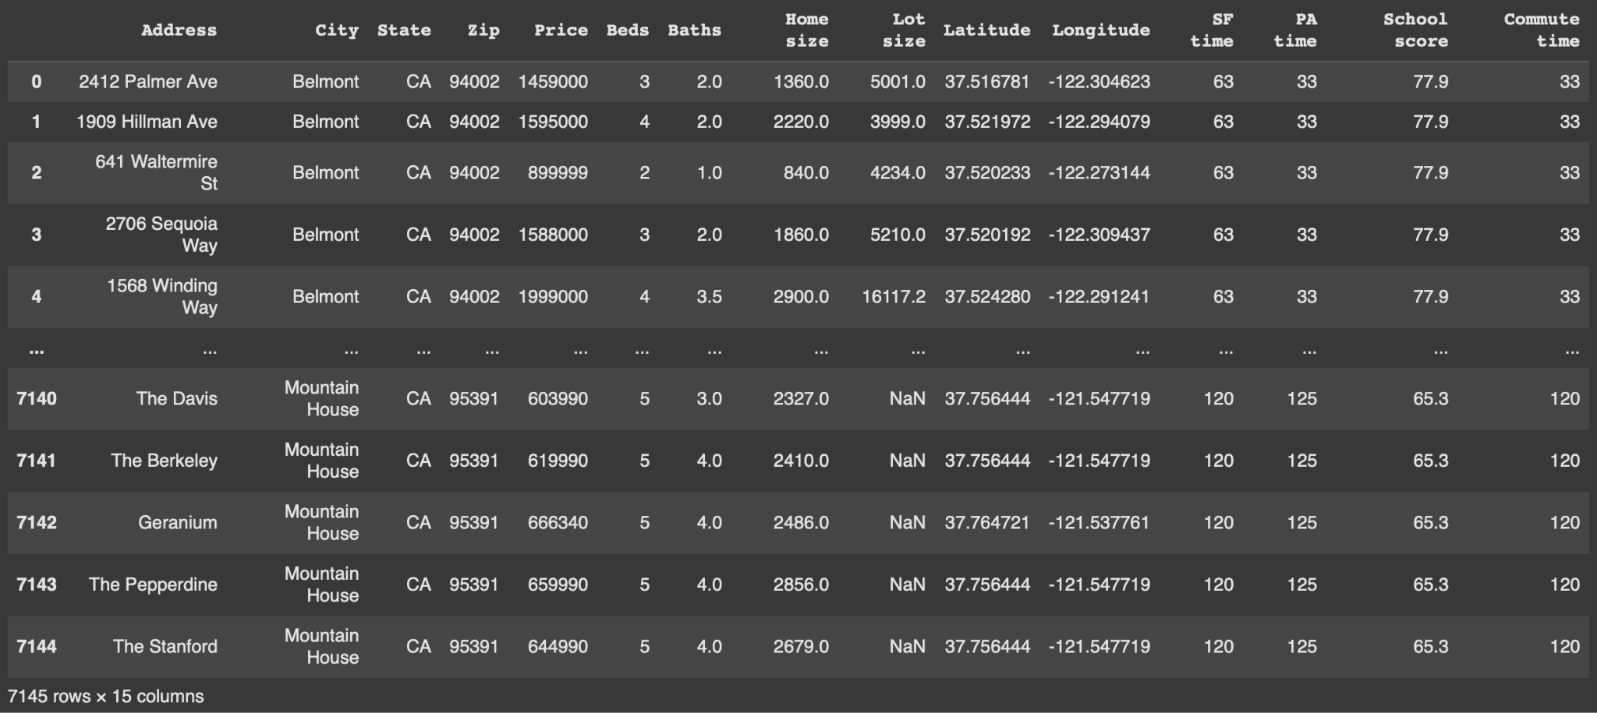
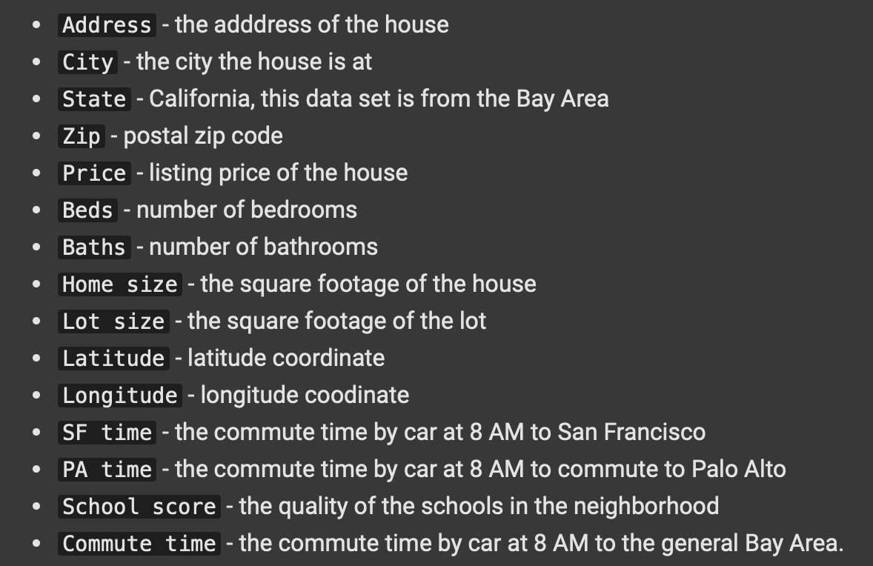
Dataset: SF Bay Area Housing
Goal: Predict the Price of Bay Area Houses
Notes:
Averi

Slide 3
Questions / Visualizations
Notes:
Averi

Slide 4
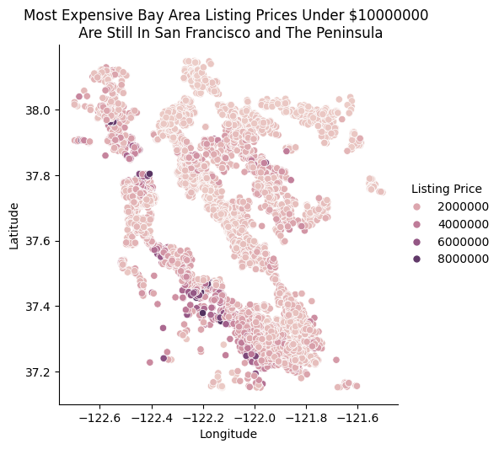
Q1: How is a house’s coordinates related to its price?
Notes:
Averi
Plot Longitude on the x-axis and Latitude on the y-axis
Use Listing Price as hue
Plots the house locations, creating a map resembling the Bay Area
The lighter the color is, the less expensive the house
The darker the color is, the more expensive the house
Most expensive houses are near San Francisco and within the Peninsula

Slide 5
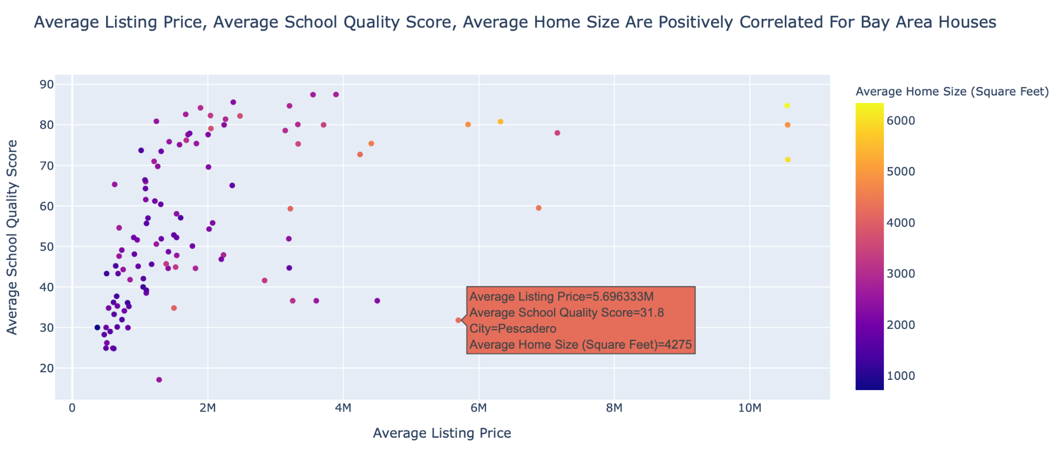
Q2: What is the average price of houses and average school quality in different cities?
Notes:
Averi
Group by ‘City’ and get the average ‘School score’, ‘Home size’, and ‘Price’
Set x-axis to average price, y-axis to average school score, hue to home size and plot the dots
Hovering over each dot displays the information for each city
Average price, school score, and home size are positively correlated

Slide 6
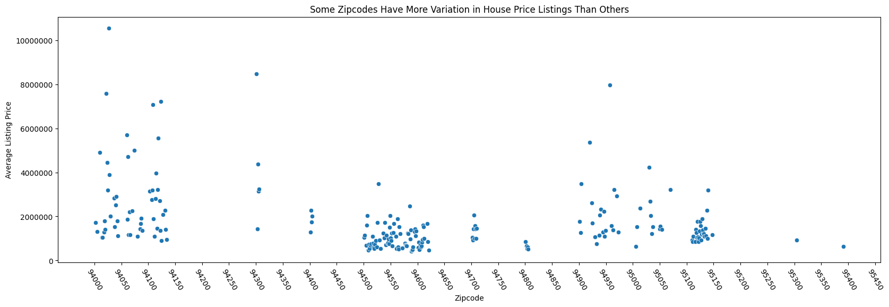
Q3: What is the relationship between zip codes and price?
Notes:
Averi
Group by zip codes, get the average house price for each zip code
Plot zip code as x-axis, average listing price as y-axis
See which zip codes are more generally more expensive and which ranges of zip codes have more variety in their average prices
Zip codes 94000 to 94150 have wildly varying average prices
Zip codes 95100 to 95150 and 94550 to 94650 have very similar average prices

Slide 7
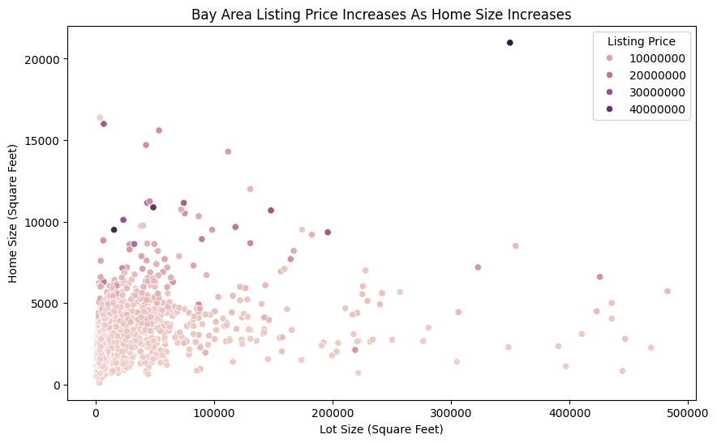
Q4: How do lot size and home size relate to the house price?
Notes:
Averi
Plot Lot Size on the x-axis and Home Size on the y-axis
Use Listing Price as hue
See trend of prices across Lot Size from left to right, across Home Size bottom to top
The lighter the color is, the less expensive the house
The darker the color is, the more expensive the house
Little correlation between price and lot size
Stronger correlation between price and home size

Slide 8
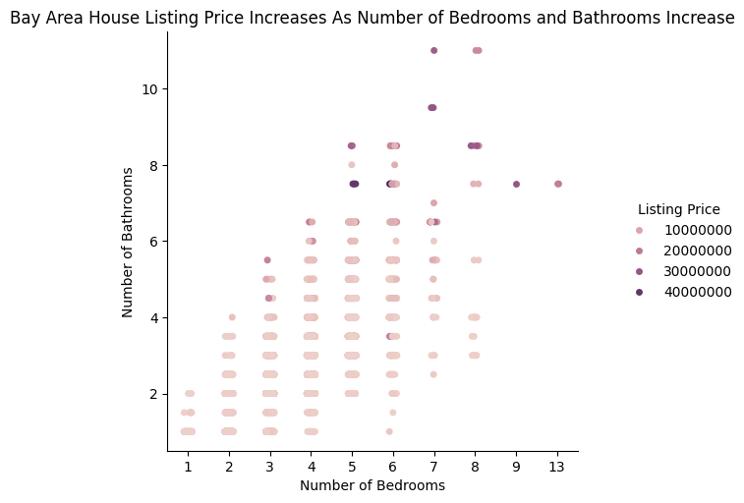
Q5: Does having more rooms (bedrooms, bathrooms) increase the price?
Notes:
Averi
Plot Number of Bedrooms on the x-axis and Number of Bathrooms on the y-axis
Use Listing Price as hue
See trend of prices across # of Bedrooms from left to right, across # of Bathrooms bottom to top
The lighter the color is, the less expensive the house
The darker the color is, the more expensive the house
Appears positively correlated between # of Bedrooms, # of Bathrooms, Listing Price

Slide 9
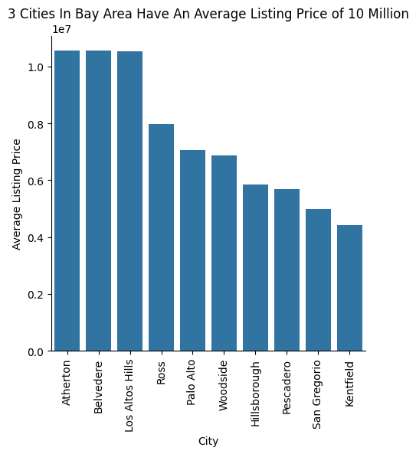
Q6: What are the 10 most expensive cities to live in?
Notes:
Averi
Plot City on the x-axis and Average Listing Price on the y-axis
Top three most expensive cities have an average listing price of over 10 million dollars
The next highest is just under 8 million dollars
Lowest of top ten most expensive cities averages around 4-5 million dollars for listing price

Slide 10
Preparing Data for Machine Learning

Slide 11

How Data Visualization Helps
ML Goal: Predict the Price of Bay Area Houses
Notes:
SANIA
Data visualization lets you see the trends in the data more clearly
This can help in selecting the features to use in the machine learning models
It can also help show where the outliers are in the dataset so that they can be removed
Identify columns to use as the features in the ML Models
‘Home size’, ‘School score’, ‘Beds’, ‘Baths’
Dropped null values for chosen columns using dropna() method
Visualize chosen columns as box plots to identify outliers
Remove outliers from dataset
This is the dataset used to train and test the ML Models

Slide 12
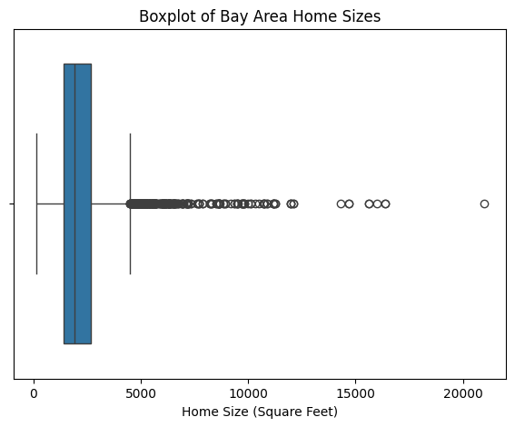
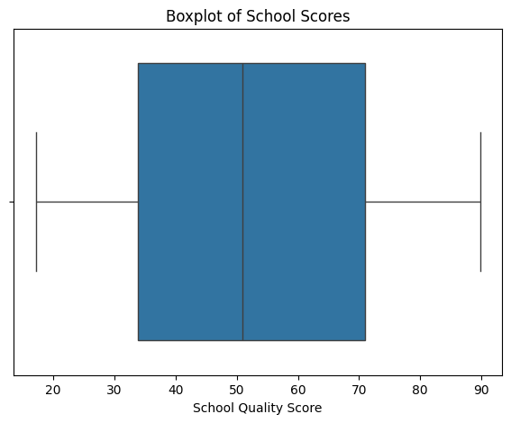
Visualize Chosen Features as Box Plots to Identify Outliers
Notes:
SANIA
BOXPLOT OF BAY AREA HOME SIZES
Majority of homes are a little under 5000 square feet
Anything above is an outlier
BOXPLOT OF SCHOOL SCORES
No outliers
Scores range from approx. 10 to 90
50% of scores are approx. between 34 to 71

Slide 13
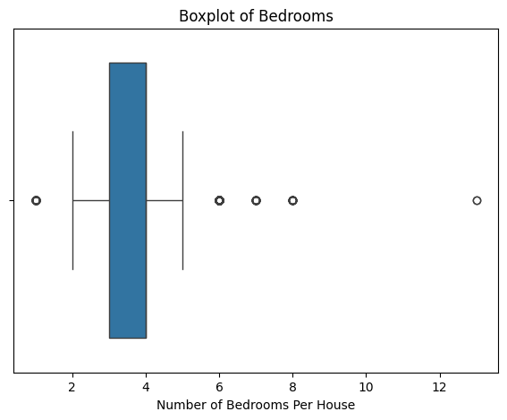
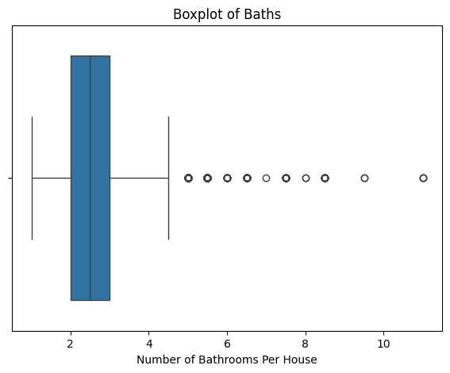
Visualize Chosen Features as Box Plots to Identify Outliers
Notes:
SANIA
BOXPLOT OF BEDROOMS
Anything under 2 or 5 bedrooms is an outlier
BOXPLOTS OF BATHS
Anything above 5 bathrooms is an outlier

Slide 14
Machine Learning
Notes:
SANIA

Slide 15
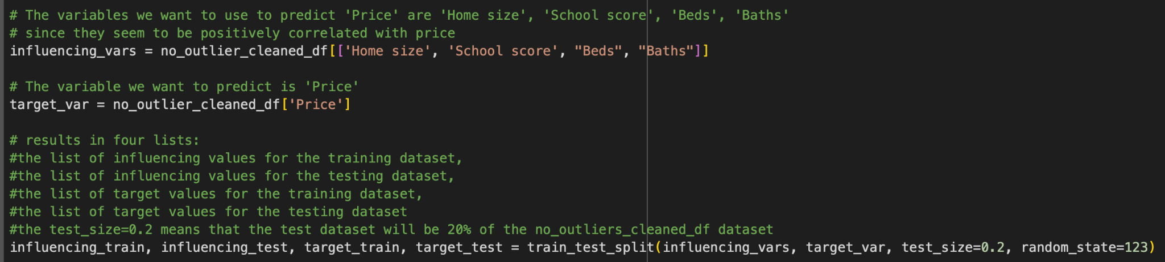
Split Dataset Into Training and Testing
Notes:
SANIA
Use scikit train_test_split() method to create training and testing set
Pass in the features you want to use to train and the feature you want to predict
Influencing_vars - Home size, School score, Beds, Baths
Showed positive correlation during data visualization step
Target_var - price
80% training data, 20% testing data
Returns list of training features, training target values, testing features, testing target values

Slide 16
Performance of Machine Learning Models
Linear Regression:
Random Forest Regression:
Decision Tree Regression:
Notes:
SANIA
Suitable because we are predicting house price which is a number, making this a regression task
Supervised learning, because we already have an idea of the target and what features may impact the target due to the visualizations
Use N fold cross validation to compare performance of models using training set
Performance measured using Mean Squared Error
The closer MSE is to 0, the better
The best model is Random Forest Regression

Slide 17
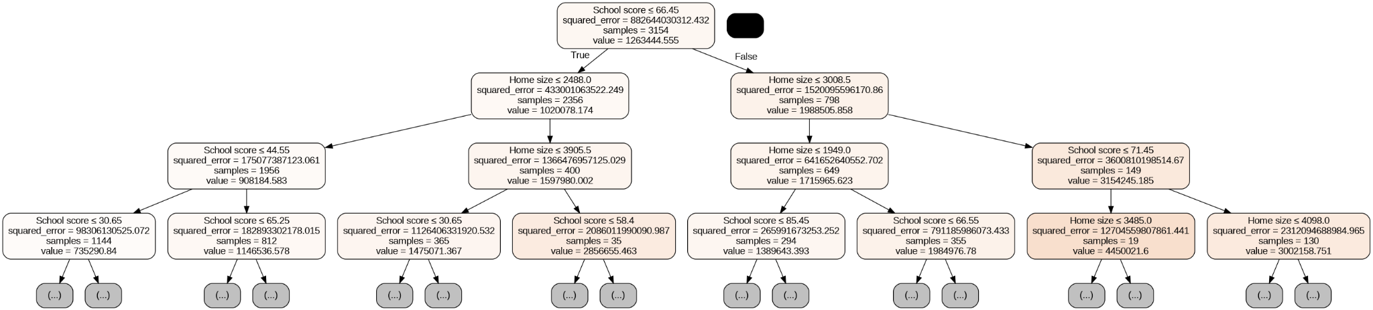
Visualization of Best ML Model (Random Forest)
The First Four Levels of The Last Decision Tree (100th) In The Random Forest:
Notes:
SANIA
Before refining
iT IS LOOKING AT FEATURES AND THEN SETTING TRUE OR FALSE AND FINALLY GIVING
Subset of one of decision trees
100th decision tree in random forest by default.

Slide 18
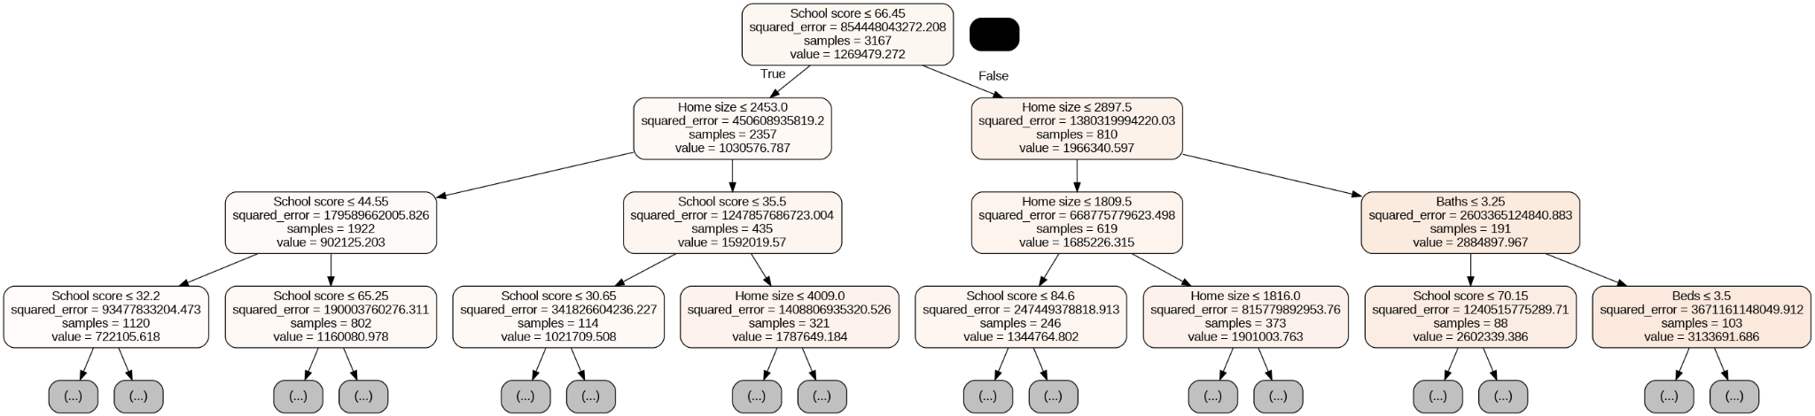
Visualization of Refined ML Model
The First Four Levels of The Last Decision Tree (1000th) In The Random Forest:
Notes:
SANIA :
After refining 1000th in the random forest.

Slide 19
Refine Best Model Using Hyperparameters and Training Data
Refine Best Model Using Hyperparameters:
Cross Validation Performance Using Refined Model And Training Data:
Notes:
SANIA
Refine best model using hyperparameters
Generally, the more n_estimators there are, the more accurate the model will be
Cross validation performance using refined model and training data
Performance during cross_validation improved

Slide 20
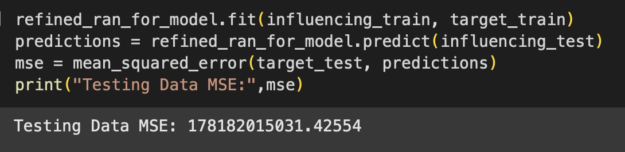
Performance of Refined ML Model Using Testing Data
Notes:
SANIA
Fit the refined random forest model using training features and training target values
Predict using the model and the testing features
Compare the predictions to the actual price values using Mean Squared Error
The closer it is to zero, the better
Better compared to performance during cross validation

Slide 21
Challenges
Notes:
Averi
Deciding what hyperparameters to use
Visualizing the Random Forest Model
Getting the list of estimators used in the Random Forest model only works if the model is fitted first
Initial print outs of the graph visualization contained too many nodes, had to restrict using max_depth parameter

Slide 22
Thank You For Listening!

